Slide 1
Introduction
COP4020
Pete Dobbins

Slide 2
Outline
Why?
…

Slide 3
Why Study Programming Languages?
Central to Computing
Helps with language selection
Easier to learn new languages
Help you make better use of the language you choose
Help you utilize tools

Slide 4
Why Study Programming Languages?
Central to Computing
What is under the hood?
How does the engine run?
Helps with language selection
Easier to learn new languages
Help you make better use of the language you choose
Help you utilize tools

Slide 5
Why Study Programming Languages?
Central to Computing
Helps with language selection
Some tasks easier in certain languages
You cannot use a language (or language type) you do not understand
Easier to learn new languages
Help you make better use of the language you choose
Help you utilize tools

Slide 6
Why Study Programming Languages?
Central to Computing
Helps with language selection
Easier to learn new languages
Similarities in language “family trees”
Conceptual similarities (iteration, recursion, etc) assist in learning
Help you make better use of the language you choose
Help you utilize tools

Slide 7
Why Study Programming Languages?
Central to Computing
Helps with language selection
Easier to learn new languages
Help you make better use of the language you choose
Understand non-obvious features (lambdas in C++/Java motivated by lambda calculus and functional programming)
Choose alternatives based upon knowledge of implementation costs (simple arithmetic: x*x instead of x**2, avoid call-by-value with large data items)
Know how to do things in languages that do not support operations explicitly
Help you utilize tools

Slide 8
Why Study Programming Languages?
Central to Computing
Helps with language selection
Easier to learn new languages
Help you make better use of the language you choose
Help you utilize tools
Assemblers
Debuggers
Linkers

Slide 9
Why Study Programming Languages?
Make better use of language technology wherever it appears or may be useful
Central to Computing
Helps with language selection
Easier to learn new languages
Help you make better use of the language you choose
Help you utilize tools

Slide 10
Why Study Programming Languages?
Make better use of language technology wherever it appears or may be useful
Central to Computing
Helps with language selection
Easier to learn new languages
Help you make better use of the language you choose
Help you utilize tools
Tool Customization

Slide 11
Why Study Programming Languages?
Make better use of language technology wherever it appears or may be useful
Central to Computing
Helps with language selection
Easier to learn new languages
Help you make better use of the language you choose
Help you utilize tools
Tool Customization
Structured Data
Parse → Analyze → Generate → Optimize → Manipulate

Slide 12
Programming Languages Give Us…
Ways of expressing algorithms
Abstraction of virtual machine
Formal notations

Slide 13
Topics
Syntax: describe legal program
Specification of programming languages
Programming language spectrum
Design and implementation issues
Points of view
Thematic organization for our sequence
Semantics: describe program meaning
Operational
Denotational
Axiomatic
Attribute Grammar

Slide 14
Topics
Imperative
Specification of programming languages
Programming language spectrum
Design and implementation issues
Points of view
Thematic organization for our sequence
Declarative
functional
logic
query
Concurrent

Slide 15
Topics
Language Features
Specification of programming languages
Programming language spectrum
Design and implementation issues
Points of view
Thematic organization for our sequence
Compilers
Interpreters

Slide 16
Topics
Designer
Specification of programming languages
Programming language spectrum
Design and implementation issues
Points of view
Thematic organization for our sequence
Implementer
User
We care about all three!

Slide 17
Topics
Specification of programming languages
Programming language spectrum
Design and implementation issues
Points of view
Thematic organization for our sequence
Functional Programming
arranged to meet the needs of our project
leverage material synergy
Denotational Semantics

Slide 18
Why So Many Languages?
Language Evolution
Special Purposes
Personal Preferences

Slide 19
What Makes a Language Successful?
Expressive power
Ease of implementation and availability
Ease of use for novice
Standardization
Excellent compilers
Economics, patronage, and inertia

Slide 20
Interplay between Design and Implementation
Perspective of language implementer and the programmer
We will consider:
Cases where implementation ease or difficulty affected language success
Language features now viewed as mistakes
Useful features that were omitted
Machine architecture making a feature too expensive
Other tradeoffs…

Slide 21
History of Languages
Machine Language
Assembly Language
High Level Languages

Slide 22
Language Spectrum
Different languages support different programming paradigms
Declarative languages focus on “what”
Imperative languages focus on “how”

Slide 23
Declarative Language Families: Functional
Computational model based on recursive definition of functions
Computation is evaluation of an expression
Normal mathematical reasoning works
Lisp, Scheme, ML, Haskell, OCaml, Kotlin

Slide 24
Declarative Language Families: Dataflow
Model computation through the flow of information between nodes
Inherently parallel
ID, Val, Lucid

Slide 25
Declarative Language Families: Logic
Constraint-based
Inspired by predicate logic
Computation attempts to find values that satisfy certain relationships using goal directed search through a list of rules
Prolog, SQL, XSLT, programmable spreadsheets

Slide 26
Imperative Language Families: von Neuman
Base means of computation is variable modification
Based on statements [assignments] with side effects
Fortran, Ada, Pascal, C

Slide 27
Imperative Language Families: Object Oriented
Related to von Neuman
More structured and distributed view of memory and computation
Computation is a collection of interactions between “objects” with their own internal state and routines to manage the state
Simula 67, Smalltalk, C++, Eiffel, Java, C#

Slide 28
Imperative Language Families: Scripting
Subset of von Neuman
Focus on “gluing” independently developed components together
Flexibility and ease of programming more than efficiency
Often “dynamic”
csh, bash, awk, PHP, JavaScript, Perl, Python, Ruby, TCL, Groovy, Lua

Slide 29
Imperative Language Families: DSL / Embedded
Domain Specific Languages
Embedded Languages

Slide 30
GC in C, OCaml, and Prolog
C
int gcd( int a, int b ) {
While ( a != b ) {
if ( a > b ) a = a – b;
else b = b – a;
}
return a;
}
OCaml
let rec gcd a b =
if a = b then a
else if a > b then gcd b (a – b)
else gcd a (b – a)
Prolog
gcd(A,B,G) :- A = B, G = A
gcd(A,B,G) :- A > B, C is A-B, gcd(C,B,G)
gcd(A,B,G) :- A > B, C is B-A, gcd(C,A,G)

Slide 31
Concurrent Languages
Concurrent vs sequential is mostly independent of the declarative vs imperative classification
Researchers are investigating expressing concurrency in all of the language classes mentioned previously
Currently, most concurrent programs written with special library packages and / or compilers together with a sequential language
A few widely used languages (Java, C#, Ada, C++11, Go, and Matlab) have explicitly concurrent features

Slide 32
Language Translation
Compilation
Interpretation
Combination

Slide 33
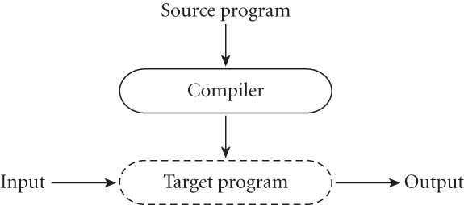
Compilation: High Level View
Compiler translates source
Produces object code written to a file in a form understood by the OS

Slide 34
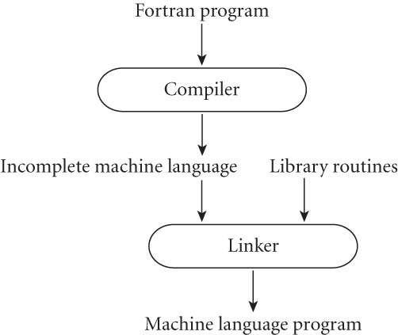
Example: Fortran
Almost pure compilation
Linker merges application with source library

Slide 35
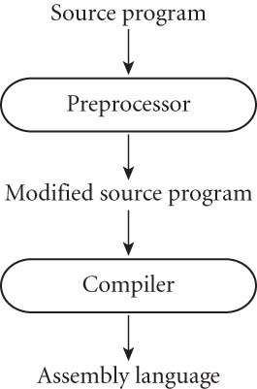
Example: C
Preprocessor removes comments and expands macros
May delete code to provide conditional compilation, allowing multiple versions from the same source
Generates assembly code

Slide 36
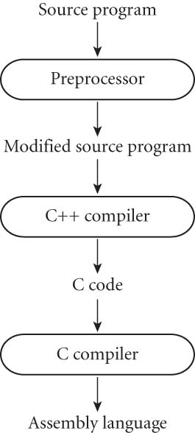
Example: [early] C++
Languages generating a known language [C]
Easier
More portable
Utilizes optimizing capabilities of the C compiler

Slide 37
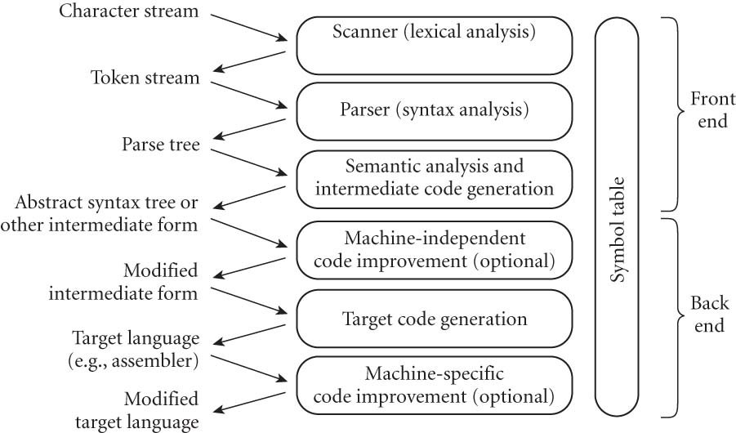
Compilation: Detailed View

Slide 38
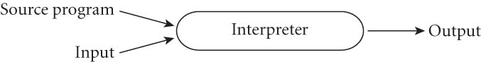
Interpreter: High Level View
Implements a virtual machine
Fetches, analyzes, and executes source code one instruction at a time
Interactive, but slower
Lisp, Prolog, many scripting languages, SQL interpreter

Slide 39
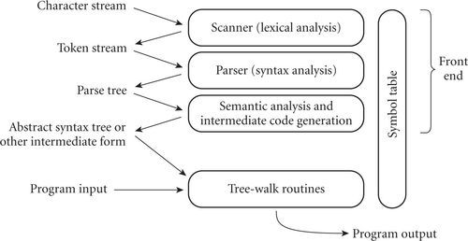
Interpretation: Detailed View

Slide 40
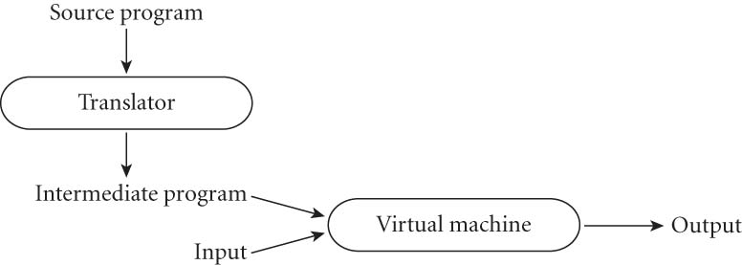
Combination
Interpreted: initial translator is “simple”
Most interpreted languages use a preprocessor to remove comments and white space, group characters (such as keywords, identifiers, numbers, and symbols) into tokens
Compiled: translator is “complicated”
Translater analyzes thoroughly
Generates code in a language that is not similar to the source langauge

Slide 41
Combination Example: Java
Early Implementation
Your Running Program
Java Source Code
Java Byte Code
javac
JVM

Slide 42
Combination Example: Java
Current Implementation
interpreted by
JIT Compiler
Java Source Code
Java Byte Code
Machine
Code
javac

Slide 43
Programming Environments
Compilers do not exist in isolation, programmers are assisted by tools.
Cross referencing: find point where object is defined given where used
Style checking and pretty printing
Configuration management
Profilers
Debuggers
IDE (Integrated Development Environments)
Editors specialized for language syntax
Internally maintain AST (abstract syntax tree)
Refactoring
Eclipse, IntelliJ, Visual Studio, XCode, …

Slide 44
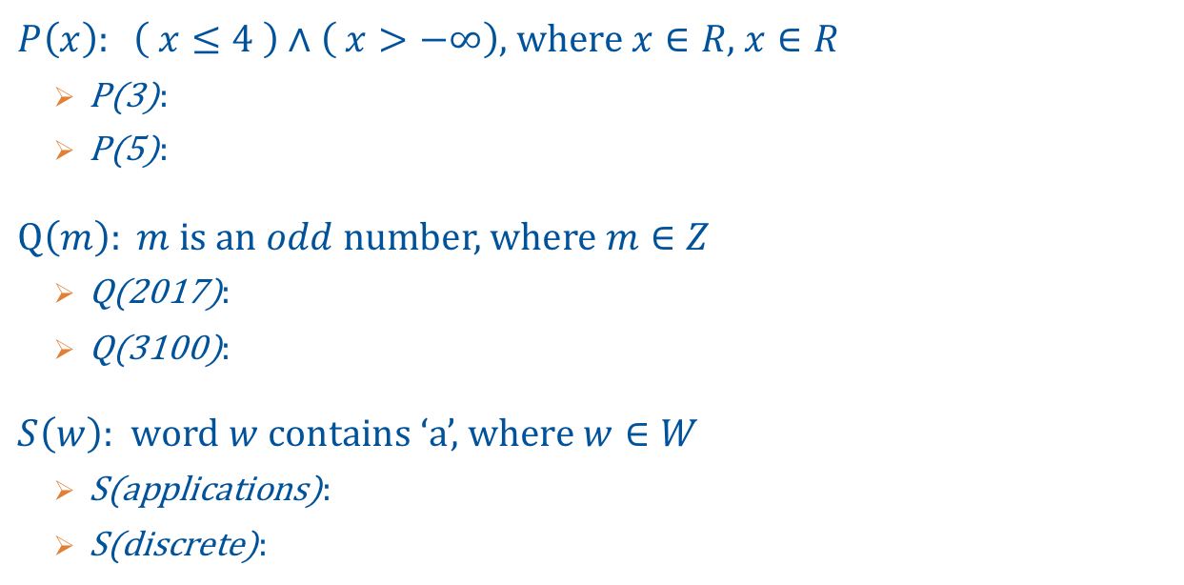
Long list…
$P\left(x\right): \left( x≤4 \right)∧\left( x>−∞\right)$, where $x∈R$, $x∈R$
P(3):
P(5):
$Q\left(m\right): m$ is an $odd$number, where $m∈Z$
Q(2017):
Q(3100):
$S\left(w\right):$ word $w$contains ‘a’, where $w∈W$
S(applications):
S(discrete):

Slide 45
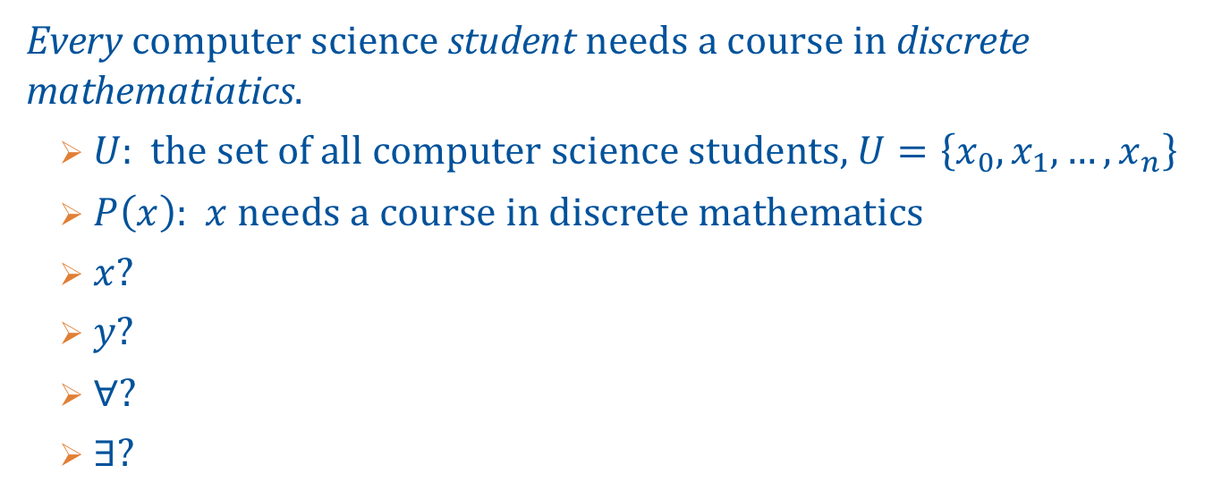
Predicate Calculus
Every computer science student needs a course in discrete mathematiatics.
$U$: the set of all computer science students, $U=\left\{x_{0},x_{1},…,x_{n}\right\}$
$P\left(x\right)$: $x$ needs a course in discrete mathematics
$x$?
$y$?
$∀$?
$∃$?

Slide 46
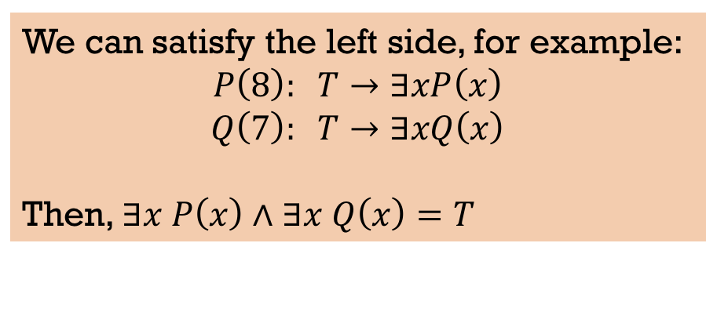
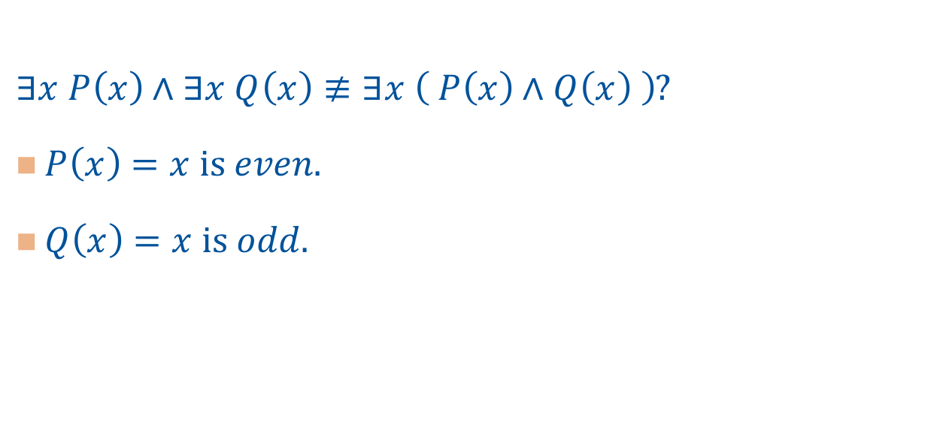

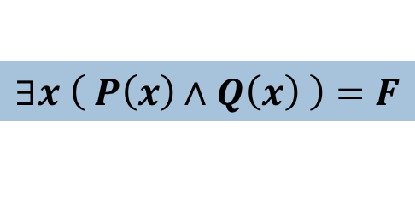
Example Proof
$∃x P\left(x\right)∧∃x Q\left(x\right)≢∃x \left( P\left(x\right)∧Q\left(x\right) \right)$?
$P\left(x\right)=x$ is $even$.
$Q\left(x\right)=x$ is $odd$.
We can satisfy the left side, for example:
$$P\left(8\right): T→∃xP\left(x\right)$$
$$Q\left(7\right): T→∃xQ\left(x\right)$$
Then, $∃x P\left(x\right)∧∃x Q\left(x\right)=T$
$$T↔F=F$$
However, there is no integer that is both even and odd at the same time, therefore…
$$∃x \left( P\left(x\right)∧Q\left(x\right) \right)=F$$

